Slide 1
Team HacknWhack
Lim Wan Loong
Lee Jia Wen
Chan See Yin
Nigel Cheong

Slide 2
TABLE OF CONTENTS
01.
Introduction
02.
Converting Research Articles
03.
04.
Conclusion
Conversational AI Features

Slide 3
01.
Introduction

Slide 4
CONTEXT
CHALLENGE
There is a rapidly growing knowledge base in the healthcare field.
Healthcare professionals find it hard to keep up with the latest research.

Slide 5
SOLUTION
Converts research articles into multimodal formats
Conversational AI features that allows healthcare professionals to interact with

Slide 6
02.
Converting Research Articles

Slide 7
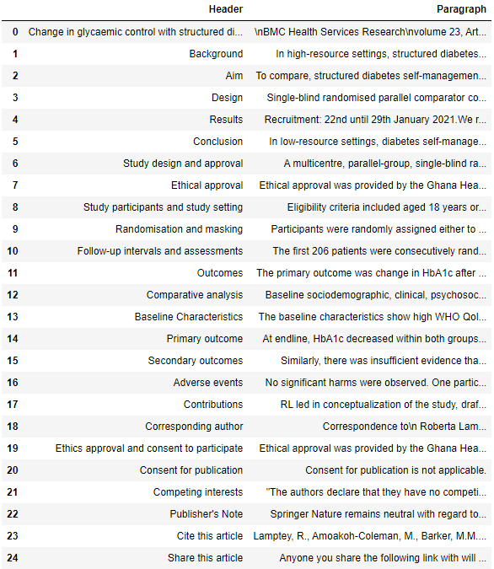
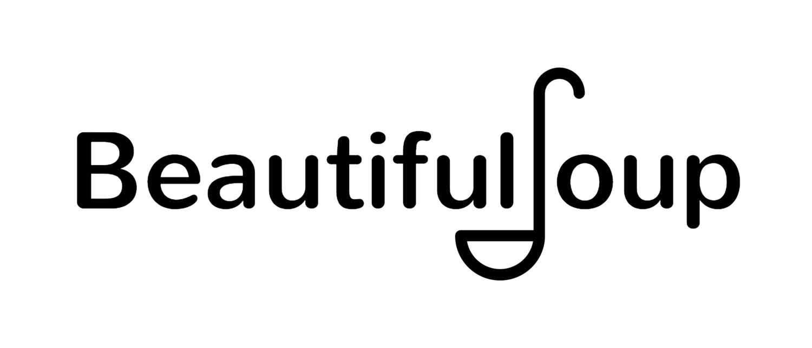
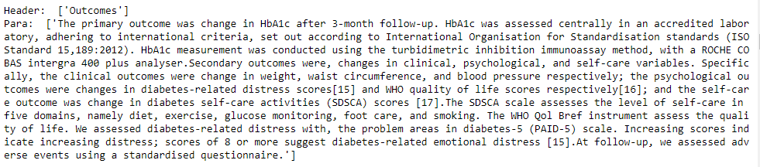
Web Scraping
Scrape research data from web pages according to HTML structure and write to dataframe

Slide 8
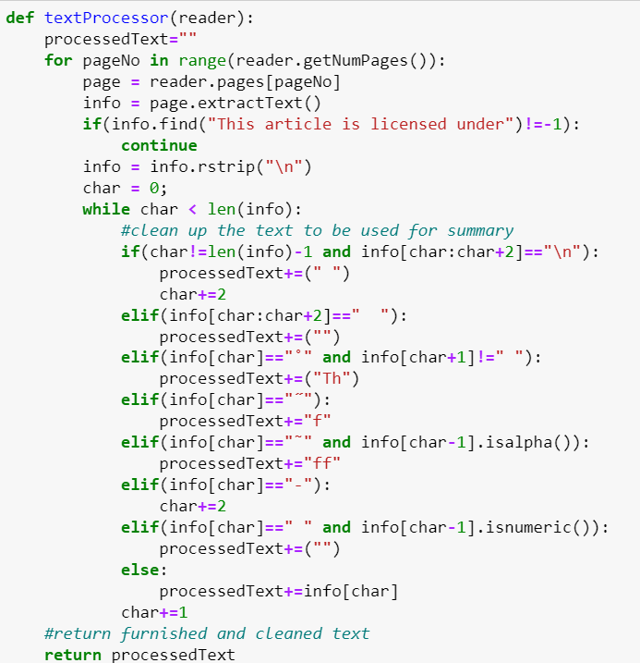
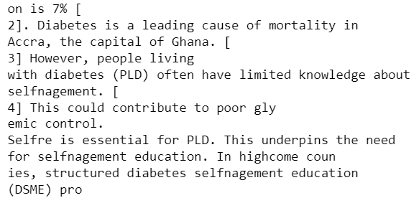
PDF Scraping - Method 1
Scraping of data with the aid of PyPDF2 to sieve out and process information to feed into our AI model.

Slide 9
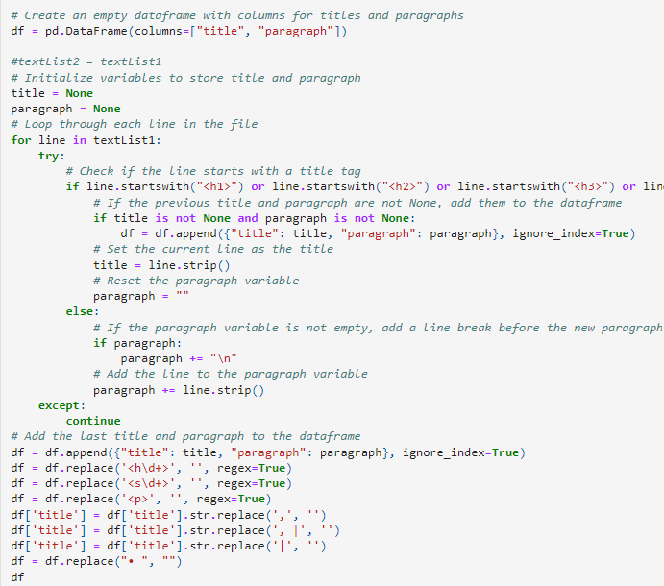
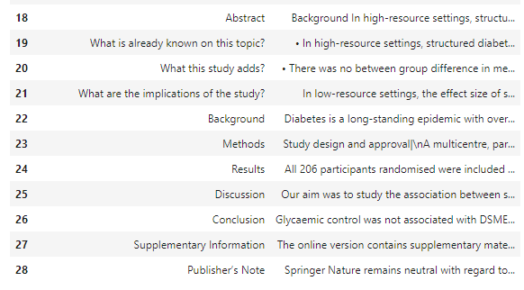
PDF Scraping - Method 2
Convert pdf into a dataframe using PyMuPDF

Slide 10
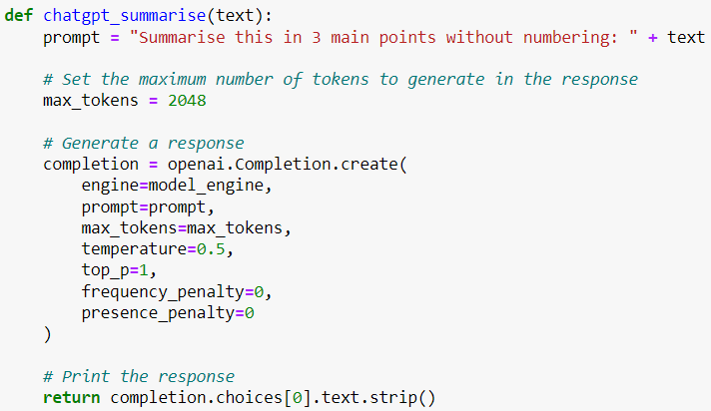

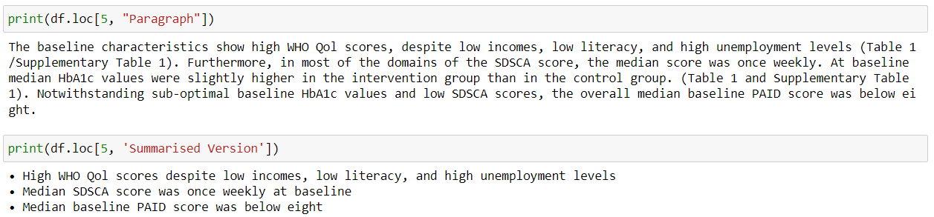
Extracting Key Insights and Findings
Integrated the power of GPT using the OpenAI API to extract the key insights and findings from research articles

Slide 11
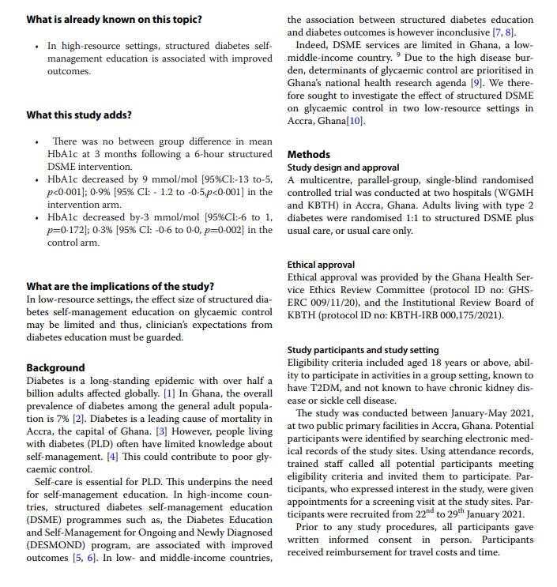
Conversion to PowerPoint

Slide 12
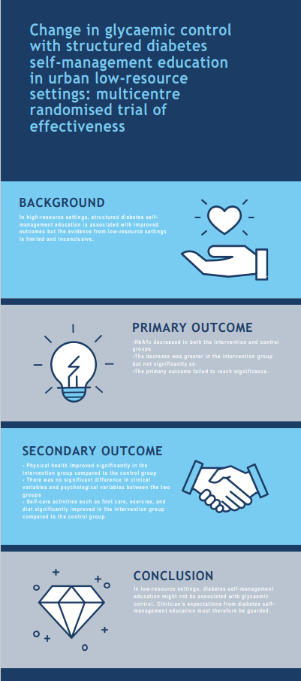
Conversion to Infographic Poster

Slide 13
03.
Conversational AI Features

Slide 14
Pre-trained BERT for QA fine tuned on SQUAD

Slide 15
04.
Conclusion

Slide 16
Future Prospects
UI which allows user to upload PDF/web link to generate summaries
More pictures/charts as visualisations in the slides and poster
Improved conversational AI based on multiple research articles

Slide 17
THANK YOU

Slide 18
CONTENTS OF THIS TEMPLATE
Here’s what you’ll find in this Slidesgo template:
A slide structure based on a medical presentation, which you can easily adapt to your needs. For more info on how to edit the template, please visit Slidesgo School or read our FAQs.
To view this template in PowerPoint with the correct fonts, download and install on your computer the fonts that we have used. You can learn how to download and install fonts here.
An assortment of graphic resources that are suitable for use in the presentation can be found in the alternative resources slide.
A thanks slide, which you must keep so that proper credits for our design are given.
A resources slide, where you’ll find links to all the elements used in the template.
Instructions for use.
Final slides with:
The fonts and colors used in the template.
A selection of illustrations. You can also customize and animate them as you wish with the online editor. Visit Storyset to find more.
More infographic resources, whose size and color can be edited.
Sets of customizable icons of the following themes: general, business, avatar, creative process, education, help & support, medical, nature, performing arts, SEO & marketing, and teamwork.
You can delete this slide when you’re done editing the presentation.

Slide 19
TABLE OF CONTENTS
01.
02.
03.
04.
OUR CENTER
KEY NUMBERS
PATIENT CARE
OUR
ADVANCES
You can describe the topic of the section here
You can describe the topic of the section here
You can describe the topic of the section here
You can describe the topic of the section here

Slide 20
INTRODUCTION
You can give a brief description of the topic you want to talk about here. For example, if you want to talk about Mercury, you can say that it’s the closest planet to the Sun in the entire Solar System

Slide 21
AWESOME WORDS

Slide 22
AWESOME WORDS

Slide 23

A PICTURE IS WORTH A THOUSAND WORDS

Slide 24

A PICTURE IS WORTH A THOUSAND WORDS

Slide 25
THIS IS A MAP
MARS
VENUS
Despite being red, Mars is actually a cold place
Venus is the second planet from the Sun
JUPITER
SATURN
Jupiter is the biggest planet in the Solar System
Saturn is a gas giant and has several rings

Slide 26
OUR CENTER
Do you know what helps you make your point clear? Lists like this one:
They’re simple
You can organize your ideas clearly
You’ll never forget to buy milk!
And the most important thing: the audience will definitely not miss the point of your presentation

Slide 27
OUR CENTER
Do you know what helps you make your point clear? Lists like this one:
They’re simple
You can organize your ideas clearly
You’ll never forget to buy milk!

Slide 28
MISSION
VISION
Mercury is the smallest planet and the closest one to the Sun
Neptune is the farthest planet from the Sun. It's also the fourth-largest

Slide 29
TWO COLUMNS
01.
MERCURY
02.
VENUS
Mercury is the closest planet to the Sun and the smallest one of them all
Venus has a beautiful name and is the second planet from the Sun

Slide 30
MILESTONES REACHED
EARTH
VENUS
It’s the third planet from the Sun
It has a beautiful name
2003-2005
2005-2007
2007-2009
2009-2011
2011-2012
PLUTO
MERCURY
MARS
It’s now considered a dwarf planet
It’s the closest planet to the Sun
It’s actually a cold place

Slide 31
OUR HISTORY
MERCURY
Mercury is the closest planet to the Sun
2003
JUPITER
Jupiter is the biggest planet of them all
2005
SATURN
Saturn is composed of hydrogen and helium
2007
NEPTUNE
Neptune is the farthest planet from the Sun
2013

Slide 32
KEY ACCOMPLISHMENTS
01.
02.
03.
MERCURY
VENUS
MARS
Mercury is the closest planet to the Sun and the smallest one
Venus has a beautiful name and is the second planet from the Sun
Despite being red, Mars is actually a cold place. It's full of iron oxide dust

Slide 33
KEY ACCOMPLISHMENTS
MERCURY
VENUS
MARS
Mercury is the closest planet to the Sun and the smallest one
Venus has a beautiful name and is the second planet from the Sun
Despite being red, Mars is actually a cold place. It's full of iron oxide dust

Slide 34
520,000
1,000
20,000
Jupiter is the biggest planet of them all
Saturn is composed of hydrogen
Mars is actually a cold place

Slide 35
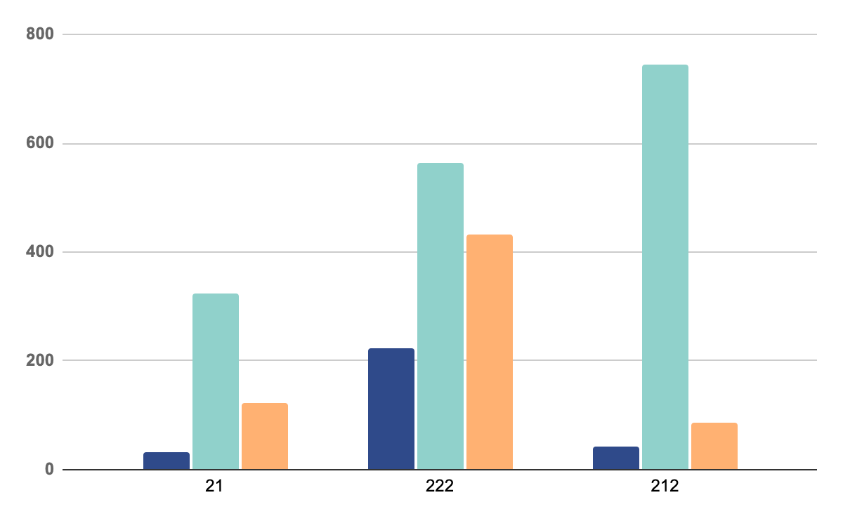
OUR GRAPHS
MERCURY
Mercury is the closest planet to the Sun and the smallest one
VENUS
Venus has a beautiful name and is the second planet
MARS
Despite being red, Mars is actually a cold place full of iron oxide
* To modify this graph, click on it, follow the link, change the data and paste the new graph here, replacing this one.
You can see how to modify the graph here

Slide 36
03.
PATIENT CARE
You can enter a subtitle here if you need it

Slide 37
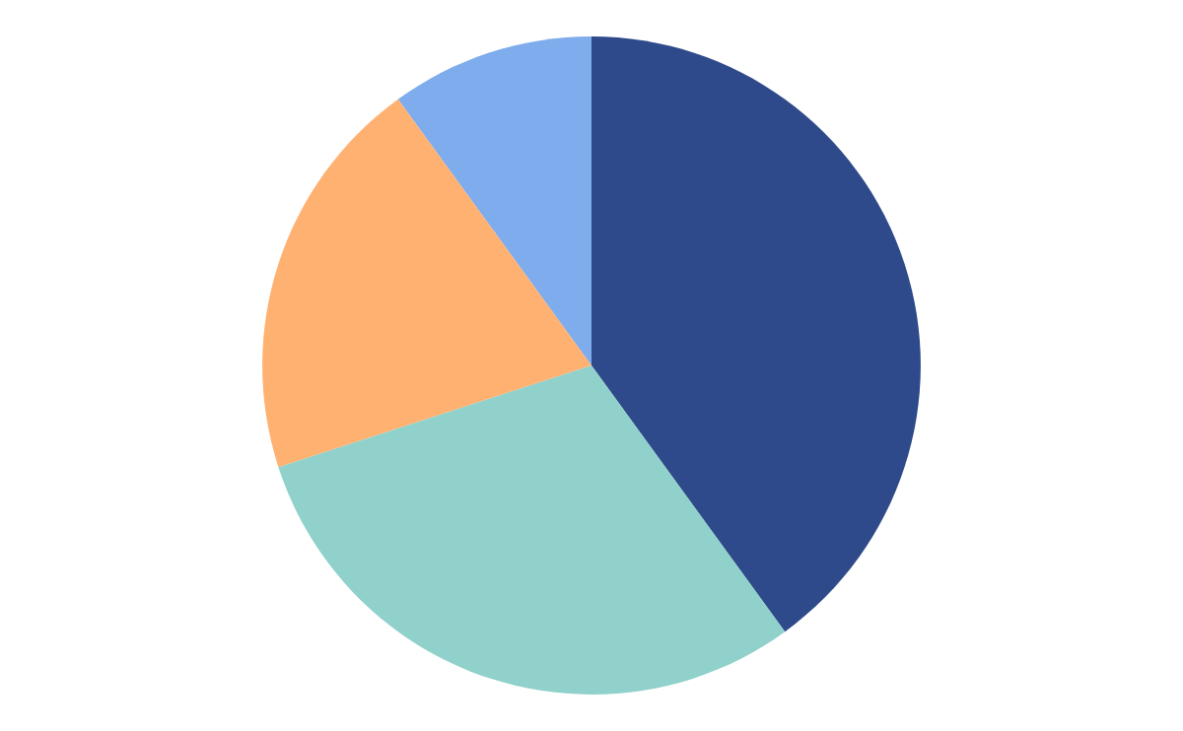
OUR GRAPHS
MERCURY
MARS
Mercury is the closest planet to the Sun and the smallest one
Despite being red, Mars is actually a cold place full of iron oxide
VENUS
SATURN
Venus has a beautiful name and is the second planet
Saturn has several rings. It's composed mostly of hydrogen
Follow the link in the graph to modify its data and then paste the new one here. For more info, click here

Slide 38
SERVICES
MERCURY
MARS
VENUS
NEPTUNE
Mercury is the closest planet to the Sun and the smallest one
Despite being red, Mars is actually a cold place. It's full of iron oxide dust
Venus has a beautiful name and is the second planet from the Sun
Neptune is the farthest planet from the Sun. It's also the fourth-largest

Slide 39
OUR SERVICES
MERCURY
JUPITER
VENUS
SATURN
MARS
PLUTO
NEPTUNE
EARTH
Mercury is the closest planet to the Sun
Jupiter is the biggest planet of them all
Venus has extremely high temperatures
Saturn is mostly composed of hydrogen
Mars is actually a very cold place
Pluto is now considered a dwarf planet
Neptune is a very far-away planet
Earth is where we all live on

Slide 40
FOUR COLUMNS
MERCURY
JUPITER
MARS
NEPTUNE
Mercury is the closest planet to the Sun and the smallest one
Jupiter is a gas giant and the biggest planet in the Solar System
Mars is actually a cold place, not hot. It's full of iron oxide dust
Neptune is a gas giant and the farthest planet from the Sun

Slide 41
QUALITY IMPROVEMENT MEASURES
 | MERCURY | MARS
JUPITER | Mercury is the smallest planet in the Solar System | Jupiter is made of gas and it’s the biggest planet of them all
SATURN | Venus is the second planet from the Sun | Saturn is a gas giant and has several rings
VENUS | Despite being red, Mars is actually a cold place | Neptune is the farthest planet from the Sun

Slide 42
GOALS
VENUS
MARS
GOAL 01
GOAL 02
GOAL 03
GOAL 04
Jupiter is the biggest planet
Mars is actually a cold place
Mercury is the smallest planet
Jupiter is a gas giant and it’s big

Slide 43
—SOMEONE FAMOUS
“This is a quote, words full of wisdom that someone important said and can make the reader get inspired.”

Slide 44
A BRIEF STORY
Saturn is a gas giant and has several rings. It's composed mostly of hydrogen and helium. It was named after the Roman god of wealth

Slide 45

A BRIEF STORY
Venus has a beautiful name and is the second planet from the Sun. It’s hot and has a poisonous atmosphere

Slide 46
OUR PROCESS
JUPITER
MERCURY
Jupiter is a gas giant and the biggest planet
Mercury is the closest planet to the Sun
NEPTUNE
PLUTO
Neptune is the farthest planet from the Sun
Pluto is considered a dwarf planet

Slide 47
OUR PROCESS
MERCURY
NEPTUNE
Mercury is the closest planet to the Sun
Neptune is the farthest planet
02
04
01
03
05
MARS
VENUS
JUPITER
Mars is actually a very cold place
Venus is the second planet from the Sun
Jupiter is the biggest planet in System

Slide 48
AWARDS
MERCURY
VENUS
MARS
Mercury is the closest planet to the Sun and the smallest one
Venus has a beautiful name and is the second planet
Despite being red, Mars is actually a cold place. It's full of iron oxide

Slide 49
AWARDS
01.
MERCURY
02.
VENUS
03.
MARS
Mercury is a very small planet
Venus is the second planet from the Sun
Mars is actually a very cold place

Slide 50

PATIENT CARE
Neptune is the farthest planet from the Sun. It's also the fourth-largest object by diameter in the Solar System

Slide 51
INNOVATION
Mercury is the closest planet to the Sun and the smallest one in the Solar System—it’s only a bit larger than the Moon

Slide 52
AREAS WE COVER
MERCURY
VENUS
MARS
JUPITER
SATURN
NEPTUNE
Mercury is the closest planet to the Sun
Venus is the second planet from the Sun
Mars is actually a very cold place
Jupiter is the biggest planet of them all
Saturn is composed of hydrogen and helium
Neptune is the farthest planet from the Sun

Slide 53
AREAS WE COVER
MERCURY
VENUS
JUPITER
SATURN
Mercury is the closest planet to the Sun
Venus is the second planet from the Sun
Jupiter is the biggest planet of them all
Saturn is composed of hydrogen and helium

Slide 54
SIX COLUMNS
MERCURY
JUPITER
VENUS
SATURN
MARS
NEPTUNE
Mercury is the closest planet to the Sun
Jupiter is the biggest planet of them all
Venus is the second planet from the Sun
Saturn is composed of hydrogen and helium
Mars is actually a very cold place
Neptune is the farthest planet from the Sun

Slide 55
KEY ACCOMPLISHMENTS
VENUS
Venus is the second planet from the Sun
SATURN
JUPITER
Saturn is composed mostly of hydrogen
Jupiter is the biggest planet in our System
MARS
Despite being red, Mars is actually cold

Slide 56
20,000,000
Big numbers catch your audience’s attention

Slide 57
KEY ACTIONS
 |  |  |  |  | DONE | TO DO
You can list here all the activities you would like to try
You can list here all the activities you would like to try
You can list here all the activities you would like to try
You can list here all the activities you would like to try
You can list here all the activities you would like to try
You can list here all the activities you would like to try

Slide 58
PATIENT SATISFACTION
JUPITER
20%
30%
MERCURY
50%
NEPTUNE
Jupiter is a gas giant and the biggest planet
Mercury is the closest planet to the Sun
Neptune is the farthest planet from the Sun

Slide 59
PATIENT SATISFACTION
95%
Mercury is the closest planet to the Sun and the smallest one in the Solar System—it’s only a bit larger than the Moon

Slide 60
KEY NUMBERS
50%
30%
20%
MERCURY
JUPITER
NEPTUNE
Mercury is the closest planet to the Sun
Jupiter is a gas giant and the biggest planet
Neptune is the farthest planet from the Sun

Slide 61
INNOVATIONS
MARS
VENUS
MERCURY
Despite being red, Mars is actually a cold place. It's full of iron oxide dust
Venus has a beautiful name and is the second planet from the Sun. It’s terribly hot
Mercury is the closest planet to the Sun and the smallest one in the Solar System

Slide 62
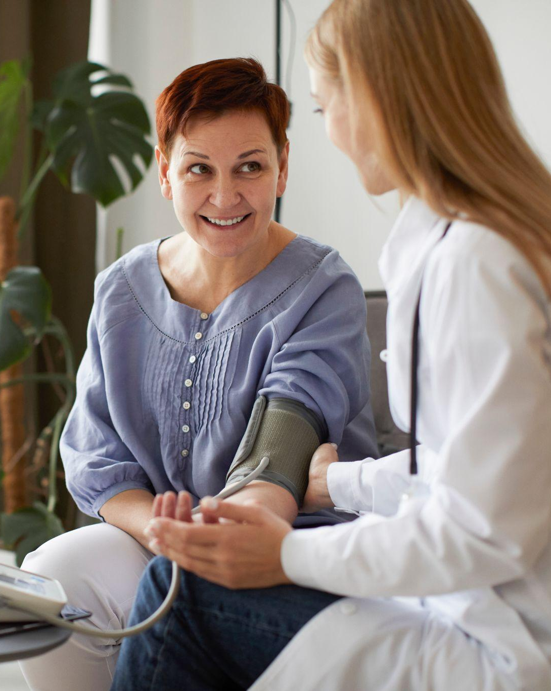
PATIENT PROFILE
75%
55%
Old women
Retired person
Mercury is the smallest one in the Solar System—it’s only a bit larger than our Moon
75%
Online shopping

Slide 63
MEDICAL CARE
JUPITER
MERCURY
Jupiter is a gas giant and the biggest planet
Mercury is the closest planet to the Sun
NEPTUNE
PLUTO
Neptune is the farthest planet from the Sun
Pluto is now considered a dwarf planet

Slide 64

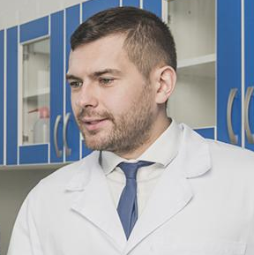
OUR TEAM
JENNA DOE
TIMMY JIMMY
You can talk a bit about this person here
You can talk a bit about this person here

Slide 65

OUR TEAM
JENNA DOE
TIMMY JIMMY
EMILY ROSE
You can talk a bit about this person here
You can talk a bit about this person here
You can talk a bit about this person here

Slide 66
TESTIMONIALS
JENNA DOE, 25
JOHN JAMES, 36
FRED BLOGGS, 31
HELENA SMITH, 58
“Mercury is the closest planet to the Sun”
“Despite being red, Mars is actually a cold place”
“Venus is the second planet from the Sun”
“Neptune is the farthest planet from the Sun”

Slide 67
TESTIMONIALS
“Mercury is the closest planet to the Sun” |  | JENNA DOE, 25
“Venus is the second planet from the Sun” |  | FRED BLOGGS, 31
“Despite being red, Mars is actually a cold place” |  | JOHN JAMES, 36
“Neptune is the farthest planet from the Sun” |  | HELENA SMITH, 58

Slide 68
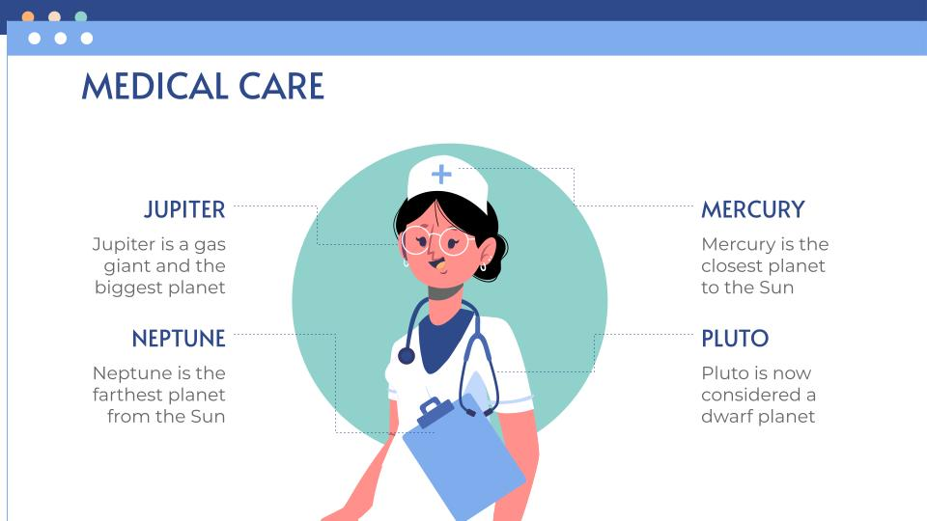
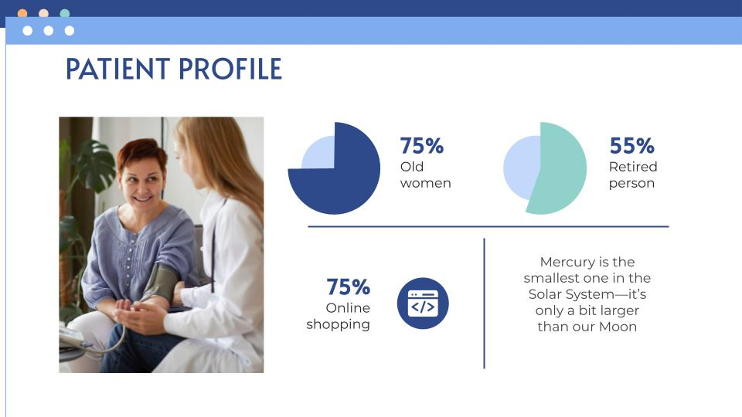
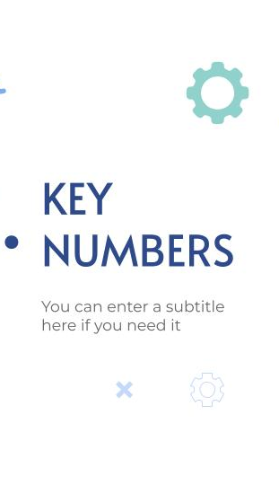
VISIT OUR WEBSITE!
You can replace the image on the screen with your own work. Just right-click on it and select “Replace image”

Slide 69
MOBILE WEB
You can replace the image on the screen with your own work. Just right-click on it and select “Replace image”

Slide 70
THANKS!
Do you have any questions?
youremail@freepik.com
+91 620 421 838
yourcompany.com
Please keep this slide for attribution

Slide 71
ICON PACK: HOSPITAL FILLED

Slide 72
ALTERNATIVE RESOURCES

